Slide 1
Agenda
ASP.Net Core
Its History
Features of .Net Core
Version History
Difference between .net and .net Core
CLI command practical use
dotnet word

Slide 2
ASP.NET Core
Sarita Lad
7 Aug 2023

Slide 3
What Is ASP.NET Core?
ASP.NET Core is a cross-platform, high-performance framework for developing modern, cloud-enabled, Internet-connected apps.
ASP.NET Core is an open-source version of ASP.NET that operates on Windows, macOS, and Linux.
ASP.NET Core was initially launched in 2016 as a revised version of older Windows- only versions of ASP.NET.

Slide 4
Version Number | Release Date | End of Support | Supported Visual Studio Version(s)
1.0 | 2016-06-27 | 2019-06-27 | Visual Studio 2015, 2017
1.1 | 2016-11-18 | 2019-06-27 | Visual Studio 2015, 2017
2.0 | 2017-08-14 | 2018-10-01 | Visual Studio 2017
2.1 long-term support | 2018-05-30 | 2021-08-21^{[7]} | Visual Studio 2017
2.2 | 2018-12-04^{[8]} | 2019-12-23^{[9]} | Visual Studio 2017 15.9 and 2019 16.0 preview 1
3.0 | 2019-09-23^{[10]} | 2020-03-03^{[9]} | Visual Studio 2017 and 2019
3.1 long-term support | 2019-12-03^{[11]} | 2022-12-03^{[9]} | Visual Studio 2019
5.0 | 2020-11-10^{[12]} | 2022-05-08 | Visual Studio 2019 16.8
6.0 long-term support | 2021-11-08^{[13]} | 2024-11-08 | Visual Studio 2022

Slide 5
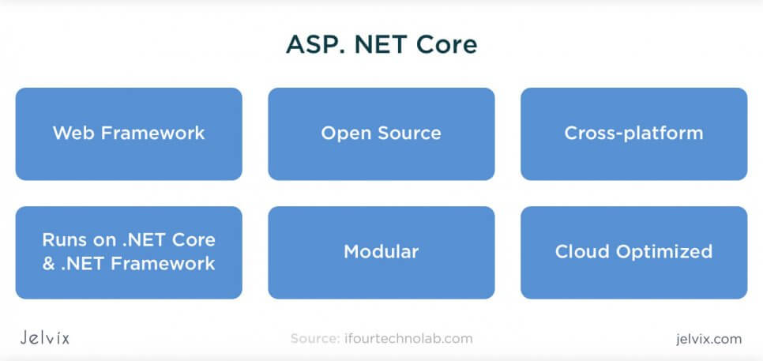
ASP.NET Core Architecure
ASP Core is a new version of ASP that became available open-source and can be executed not only on Windows but also on Linux and Mac. With this update, ASP.NET became increasingly more available to teams who usually work outside of the Microsoft ecosystem.

Slide 6
Architecture
ASP.NET Core is a Cloud platform where teams can build web and cross-platform apps from any OS. This version is a combination of Model-View Controller and WEB API within a unified development system.
With ASP Core’s MVC, users can do model binding and validation for their requests, automatically establishing parameters and converting values. Additionally, the framework supports filtering that automatically detects invalid models and blocks them for future sessions.
What used to be “References” in ASP.NET, became a Dependencies folder in ASP.NET Core. Right as you start creating the application, the platform demonstrates all default dependencies and allows you to track their increase or decrease.

Slide 7
Benefits of Using ASP.NET Core
Clear structure: the platform allows breaking applications into multiple layers, using clear architecture templates, manage business logic, and UI files.
Features are structured in Views and Controllers. Developers can organize functionality by feature folders, create separate Areas with standalone sets of Views and Controllers.

Slide 8
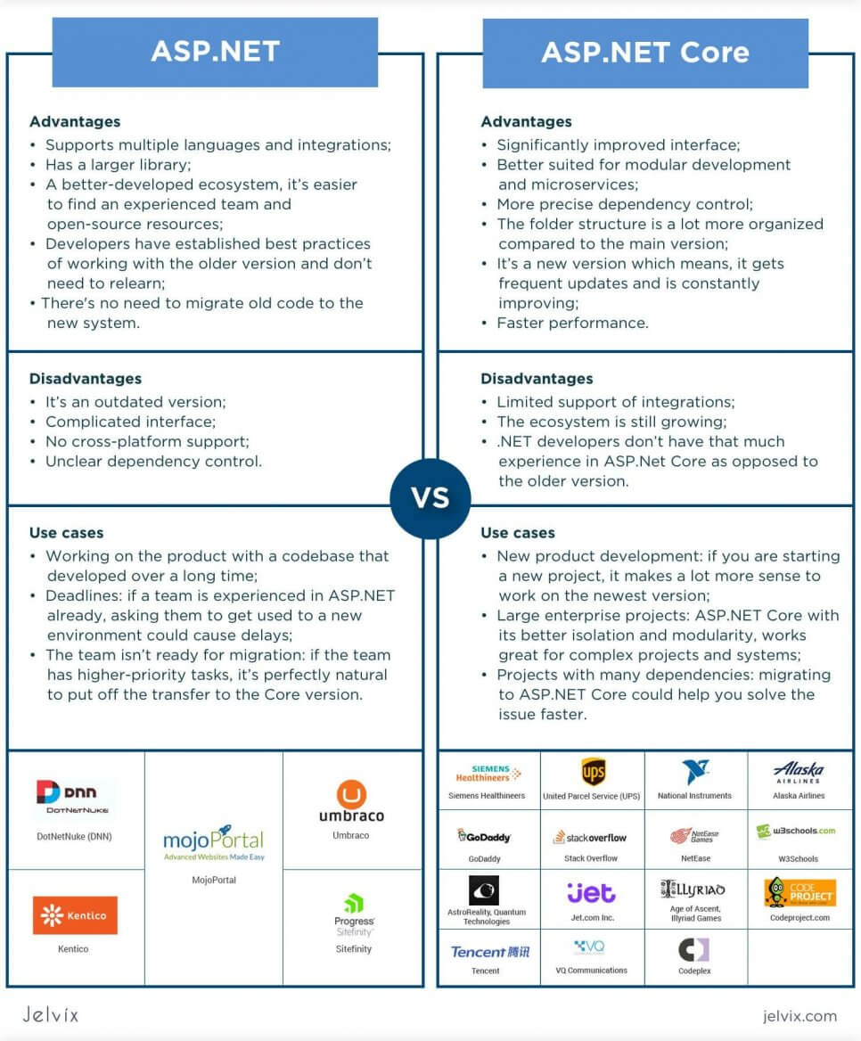
What is the difference between ASP.NET and ASP.NET Core?

Slide 9
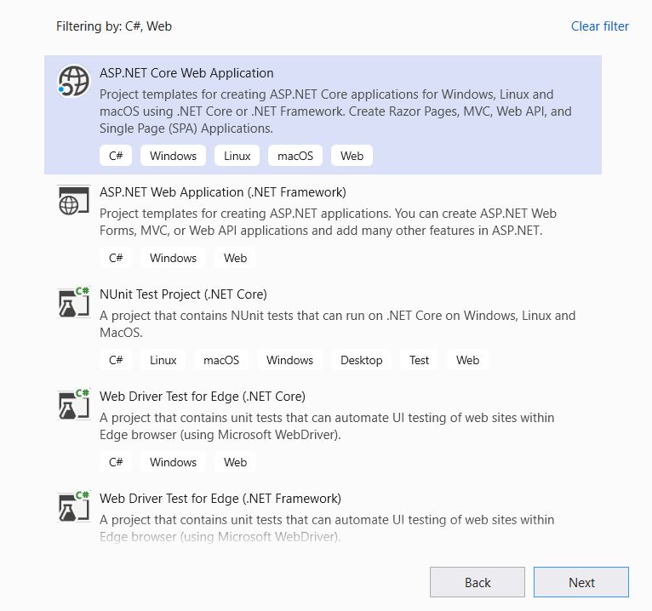
New Project

Slide 10
Hosting Of Web Application:
1 InProcess
2 OutOfProcess
By Default OutOfProcess hosting
To Change it to InProcess
Configure Project File by Adding following line
<AspNetCoreHostingModel>InProcess</AspNetCoreHostingModel>
1 InProcess
<AspNetCoreHostingModel>InProcess</AspNetCoreHostingModel>-->
If app is run from v S studio Server process name is IIS Express
If it is run from dotnet CLI
Process Name is W3Wp.Exe
2 OutOfProcess
There are 2 servers
Kestral and reverse Proxy server
(IIS,Nginx or Apache)

Slide 11
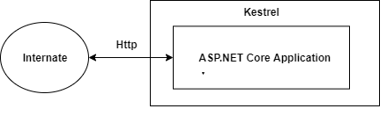
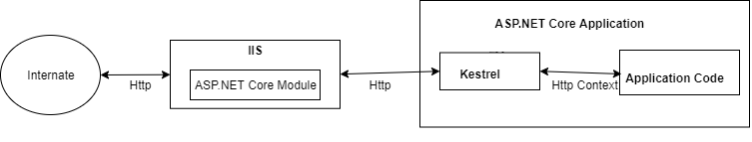
Using Kestrel
So in this type Kestrel itself acts as edge server which directly server user requests. It means that we can only use the Kestrel server for our application.
Using a Proxy Server
Due to limitations of the Kestrel server, we can not use this in all the apps. In such cases, we have to use powerful servers like IIS, NGINX or Apache. So, in that case, this server acts as a reserve proxy server which redirects every request to the internal Kestrel sever where our app is running. Here, two servers are running. One is IIS and another is Kestrel.

Slide 12
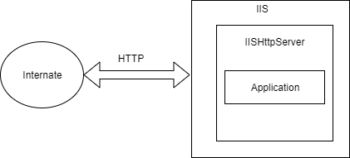
In-process Hosting Model
After the release of .NET Core 2.2, it introduced a new type of hosting which is called In-process hosting. In this type, only one server is used for hosting like IIS, Nginx or Linux. It means that the App is directly hosted inside of IIS. No Kestrel server is being used. IIS HTTP Server (IISHttpServer) is used instead of the Kestrel server to host apps in IIS directly. ASP.NET Core 3.1 onwards **In-process** hosting model is used as a default model whenever you create a new application using an existing template.

Slide 13
InProcess Hosting model
There is only one web server i.e. IIS and it run under worker process W3Wp so o/p name of process from CLI (dotnet run ) comes : MyFirstMVCApp (it is better than out of process hosting for performance)
Kestral Server is not used in InProcess Hosing.
In Out of Process there are 2 web servers involved
1 Kestral internal server name of process is dotnet.exe
2 IIS, ngNX, Apache external server called reverse proxy server (may or may not be used )
Kestral is cross platform web server
When we run from CLI : kestrel is the only server in Out of Process Server.

Slide 14
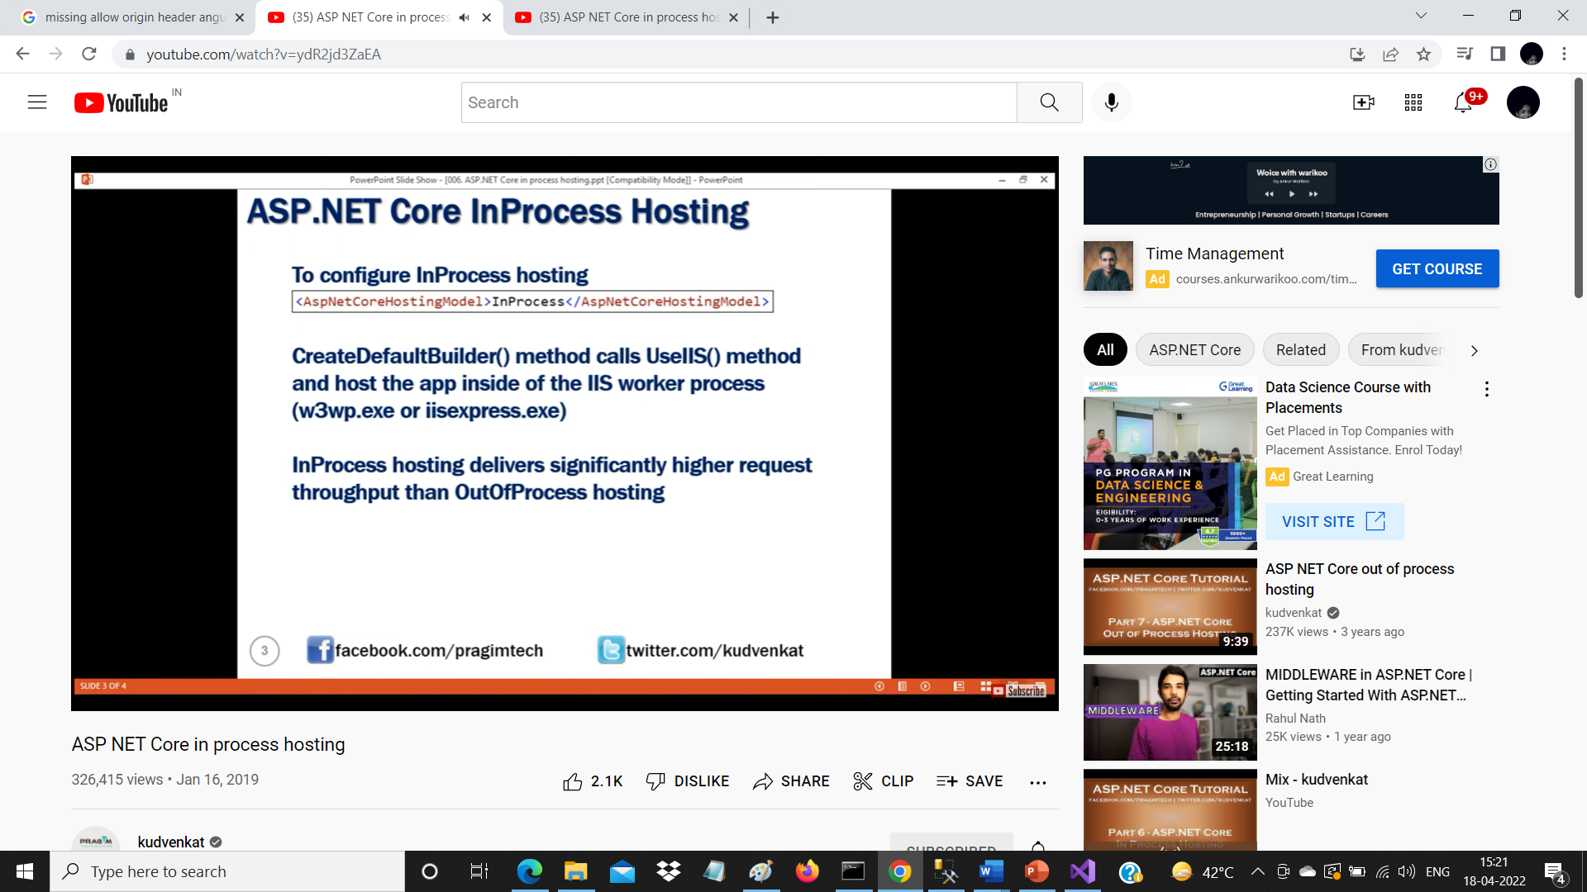
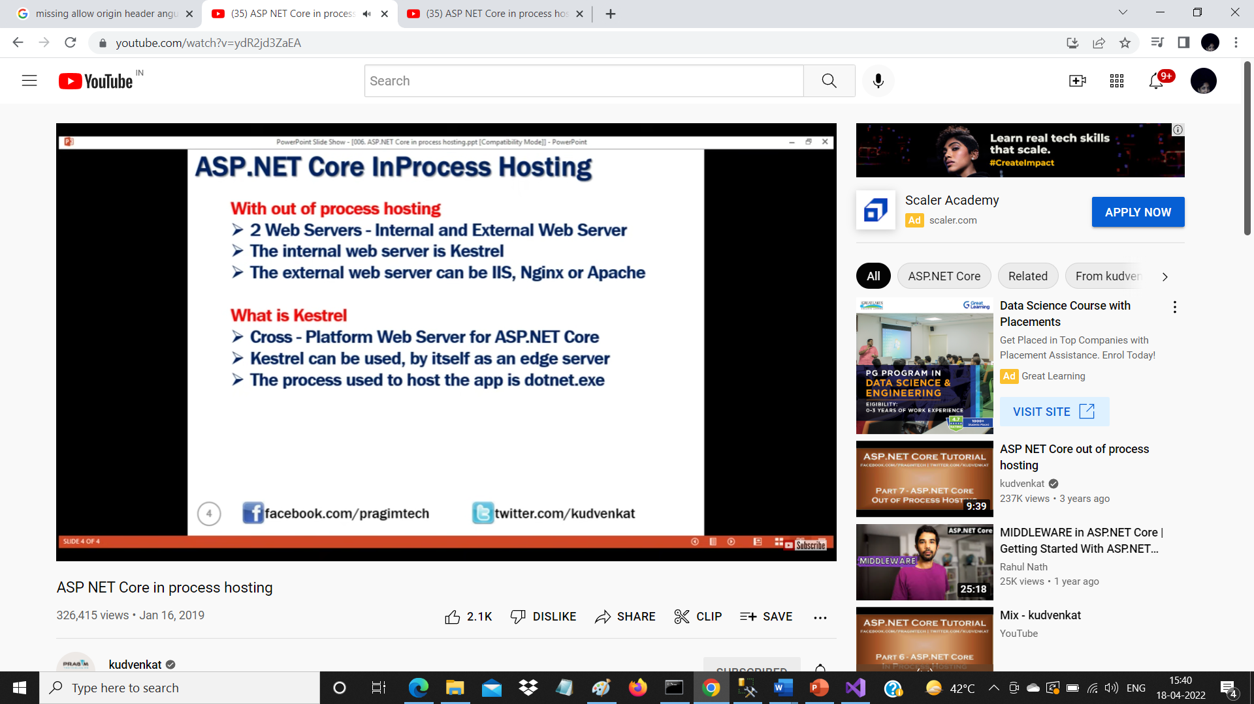

Slide 15
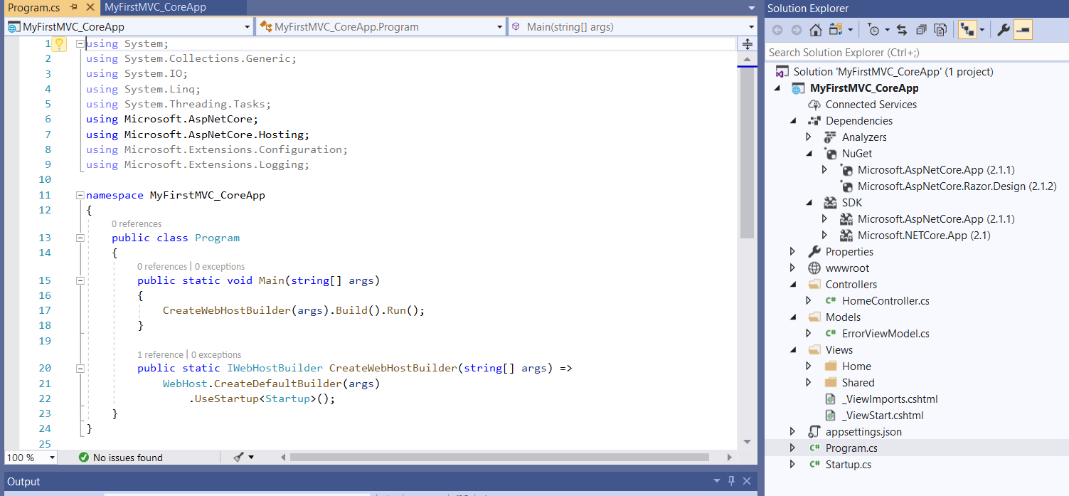
Startup Class in ASP.NET Core Application:

Slide 16
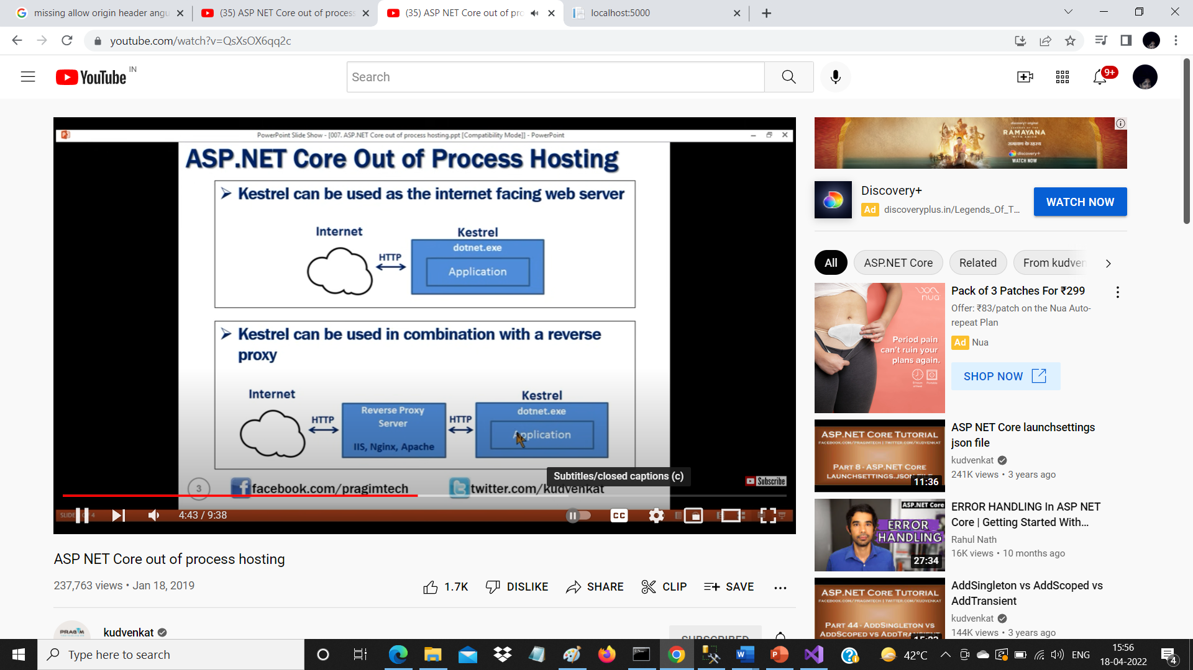

Slide 17
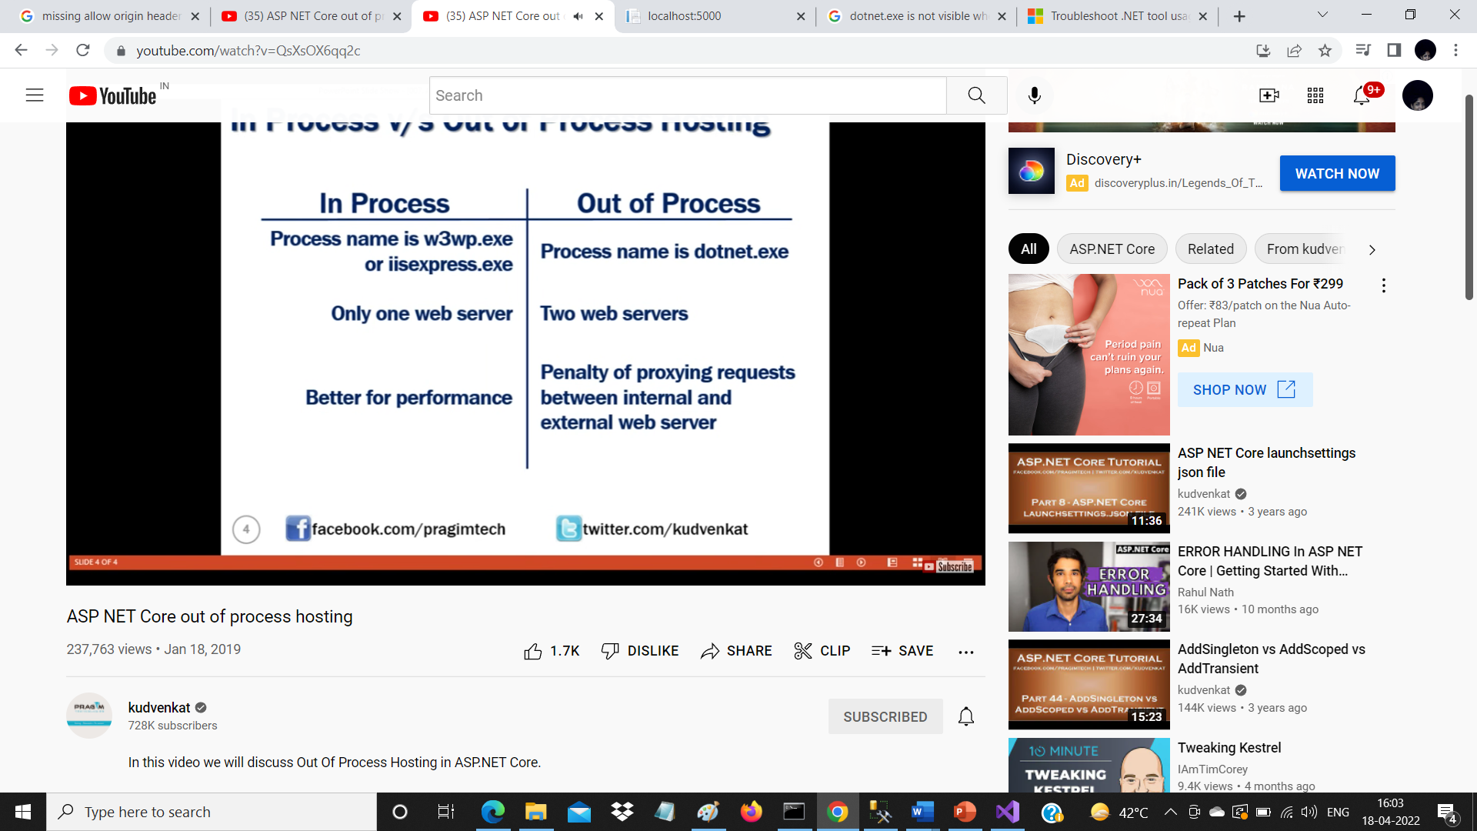
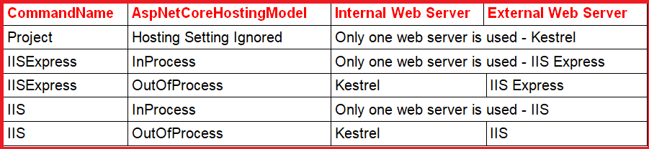
Comparison

Slide 18
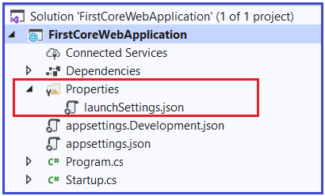
Understanding LaunchSettings.json file in ASP.NET Core
The settings that are present within this file are going to be used when we run the .NET core application either from Visual Studio or by using .NET Core CLI.
The most important point that you need to keep in mind is this launchSettings.json file is only used within the local development machine. That means this file is not required when we publishing our asp.net core application to the production server.
If you have certain settings and you want your application to use such settings when you publish and deploy your asp.net core application to the production server, then you need to store such settings in the appsettings.json file. Generally, in the ASP.NET Core application, the configuration settings are going to be stored in the appsettings.json

Slide 19
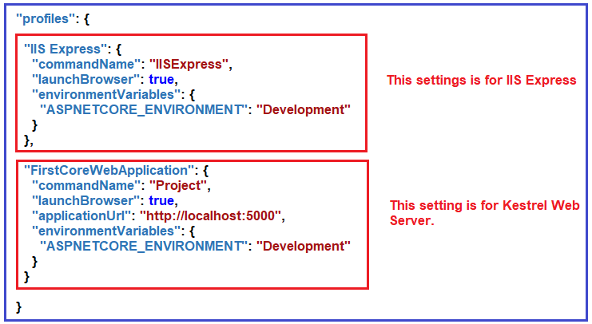
Understanding LaunchSettings.json file in ASP.NET Core

Slide 20
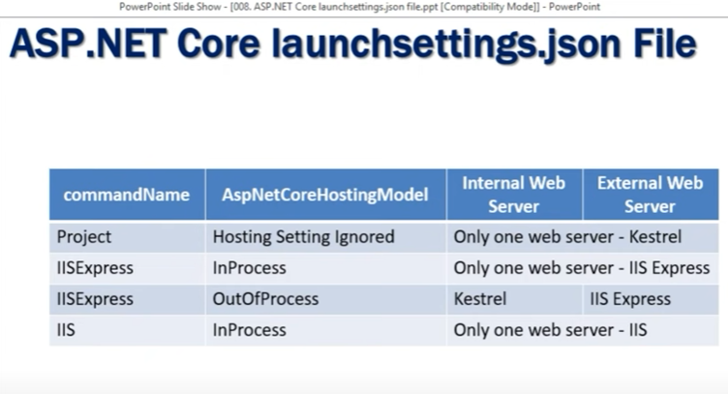

Slide 21
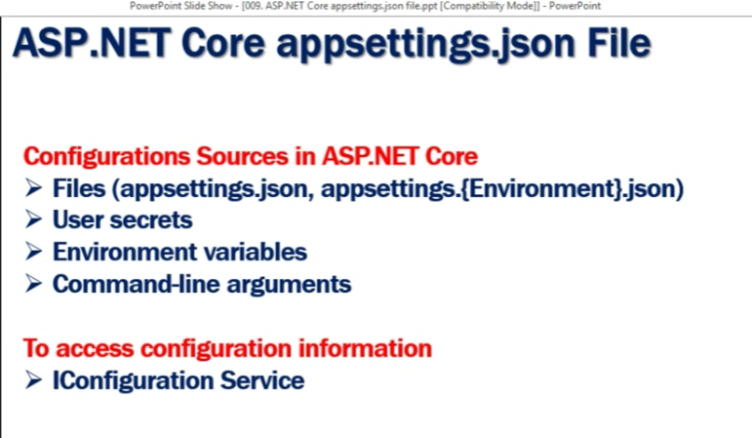

Slide 22
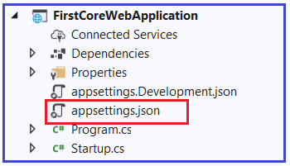
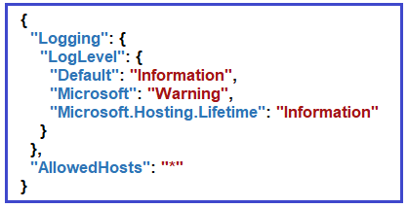
ASP.NET Core appsettings.json file
The appsettings.json file is an application configuration file used to store configuration settings such as database connections strings, any application scope global variables, etc. If you open the ASP.NET Core appsettings.json file, then you see the following code by default which is created by visual studio.

Slide 23
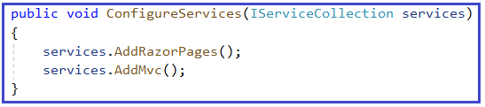
ConfigureServices() method in ASP.NET Core Startup class
The Dependency Injection pattern is used heavily in ASP.NET Core architecture. It includes the built-in IoC container to provide dependent objects using constructors.
The ConfigureServices method is a place where you can register your dependent classes with the built-in IoC container. After registering the dependent class, it can be used anywhere in the application. You just need to include it in the parameter of the constructor of a class where you want to use it. The IoC container will inject it automatically.
The ConfigureServices method includes the IServiceCollection parameter to register services to the IoC container.

Slide 24
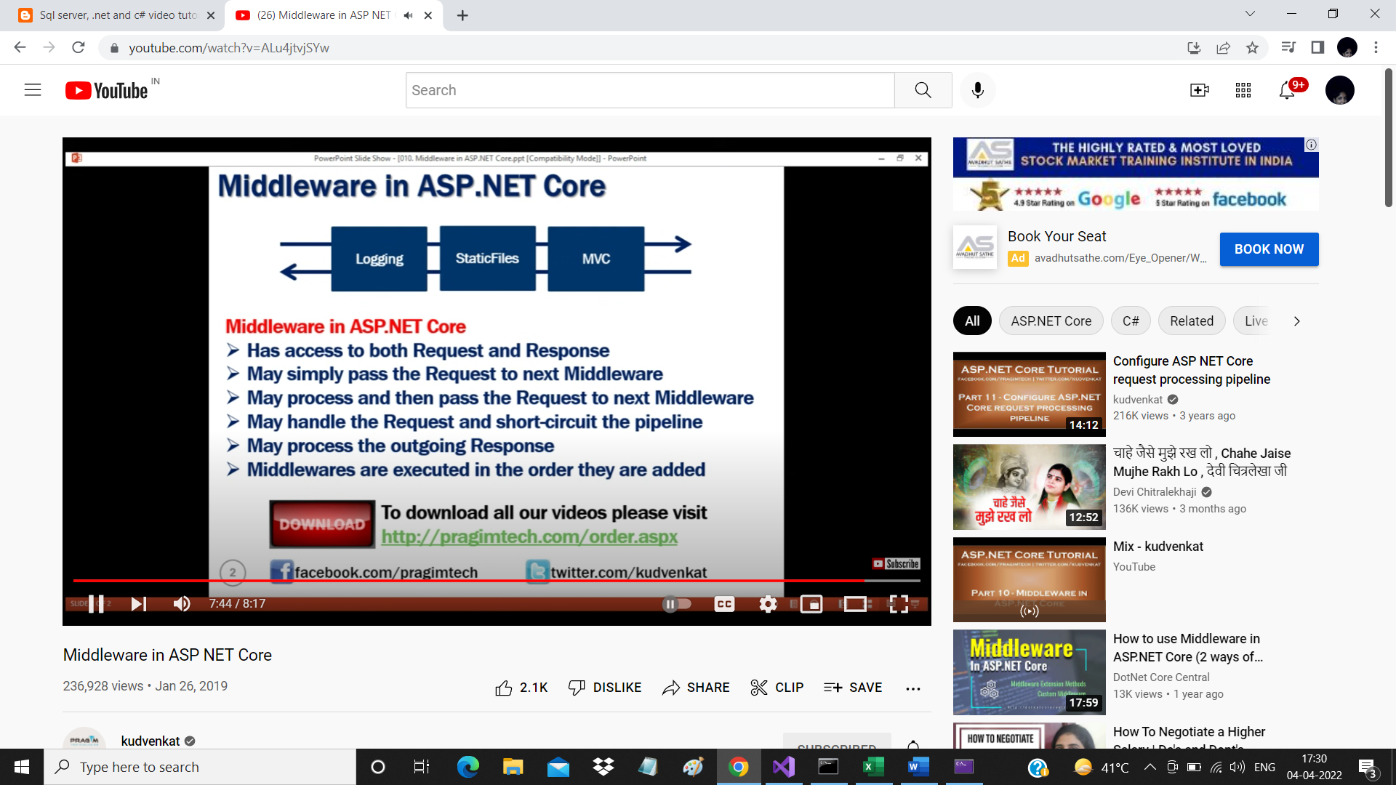
What is Middleware?
Configure() method in ASP.NET Core Startup class
The Configure method is a place where we can configure the application request pipeline for our asp.net core application using the IApplicationBuilder instance that is provided by the built-in IoC container.
ASP.NET Core introduced the middleware components to define a request pipeline, which will be executed on every request. You include only those middleware components which are required by your application and thus increase the performance of your application.

Slide 25
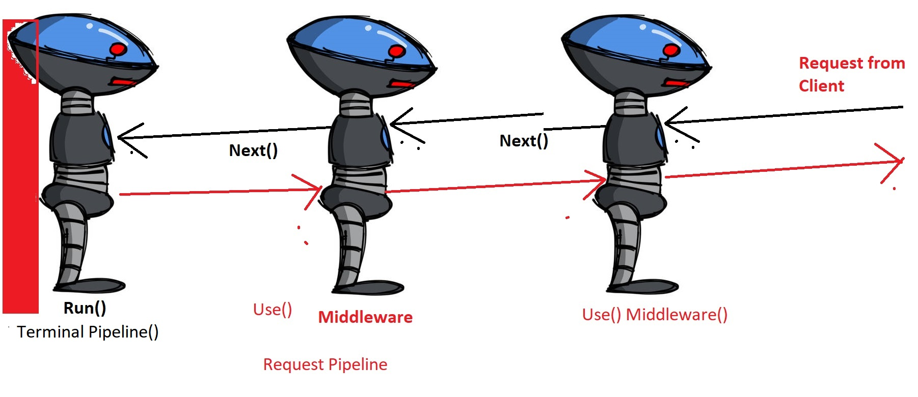
Middleware in Razor Pages
The Request Pipeline

Slide 26
What is request Pipeline middleware?
When requests are made to a web application, they need to be processed in some way. A number of considerations need to be taken into account.
Where should the request be directed or routed to?
Should details of the request be logged?
Should the application simply return the content of a file?
Should it compress the response?
What should happen if an exception is encountered while the request is being processed?
Is the person making the request actually allowed to access the resource they have requested?
How should cookies or other request-related data be handled?
Each of these processing actions are performed by separate components. The term used to describe these components is Middleware. Together, they form the request pipeline.

Slide 27
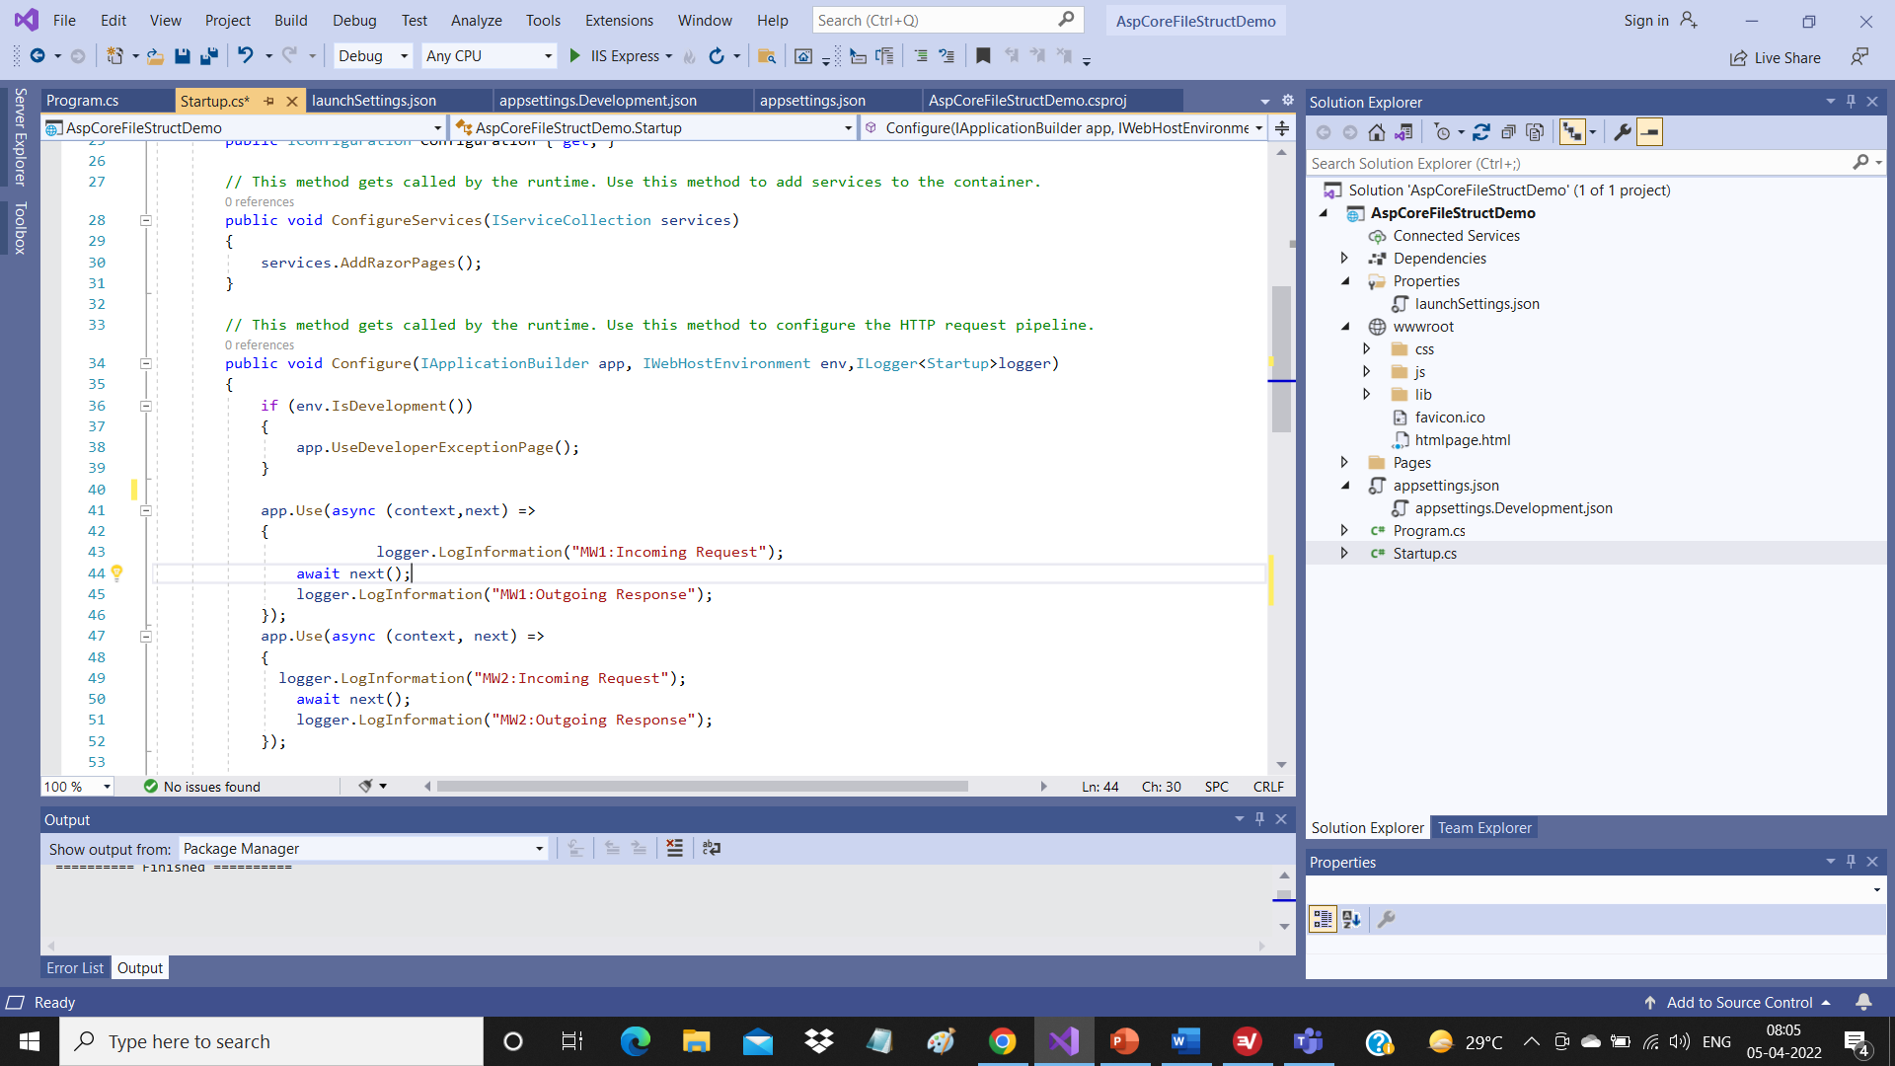
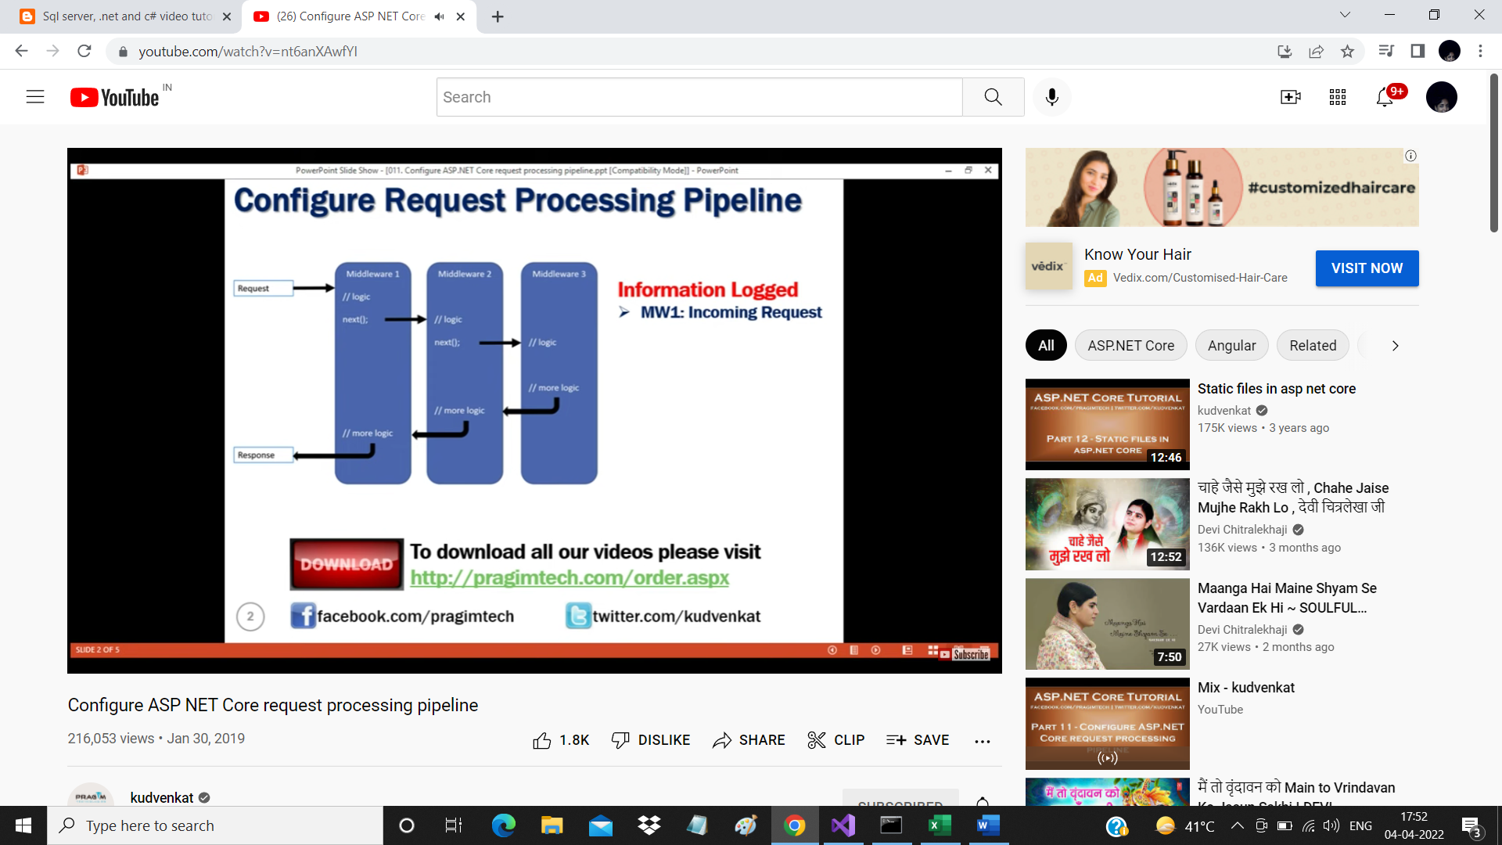

Slide 28
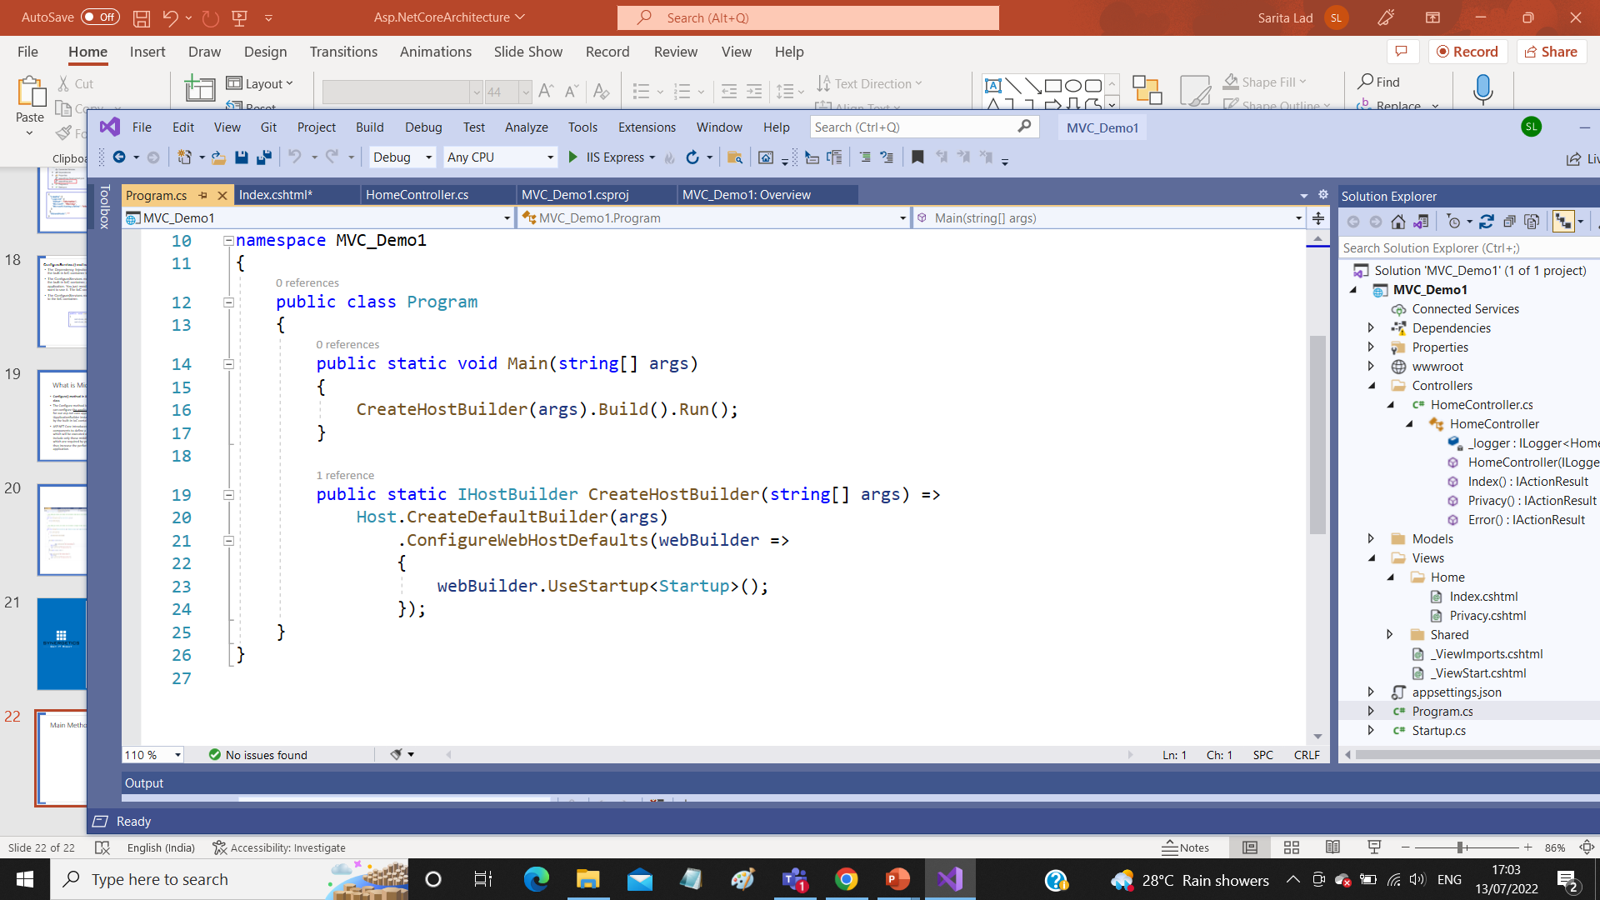
Main Method in asp.net MVC and Program File

Slide 29
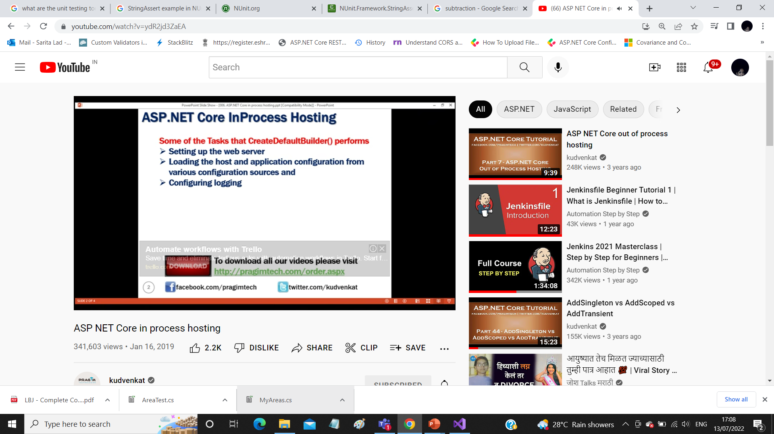
CreateDefaultBuilder() Method

Slide 30
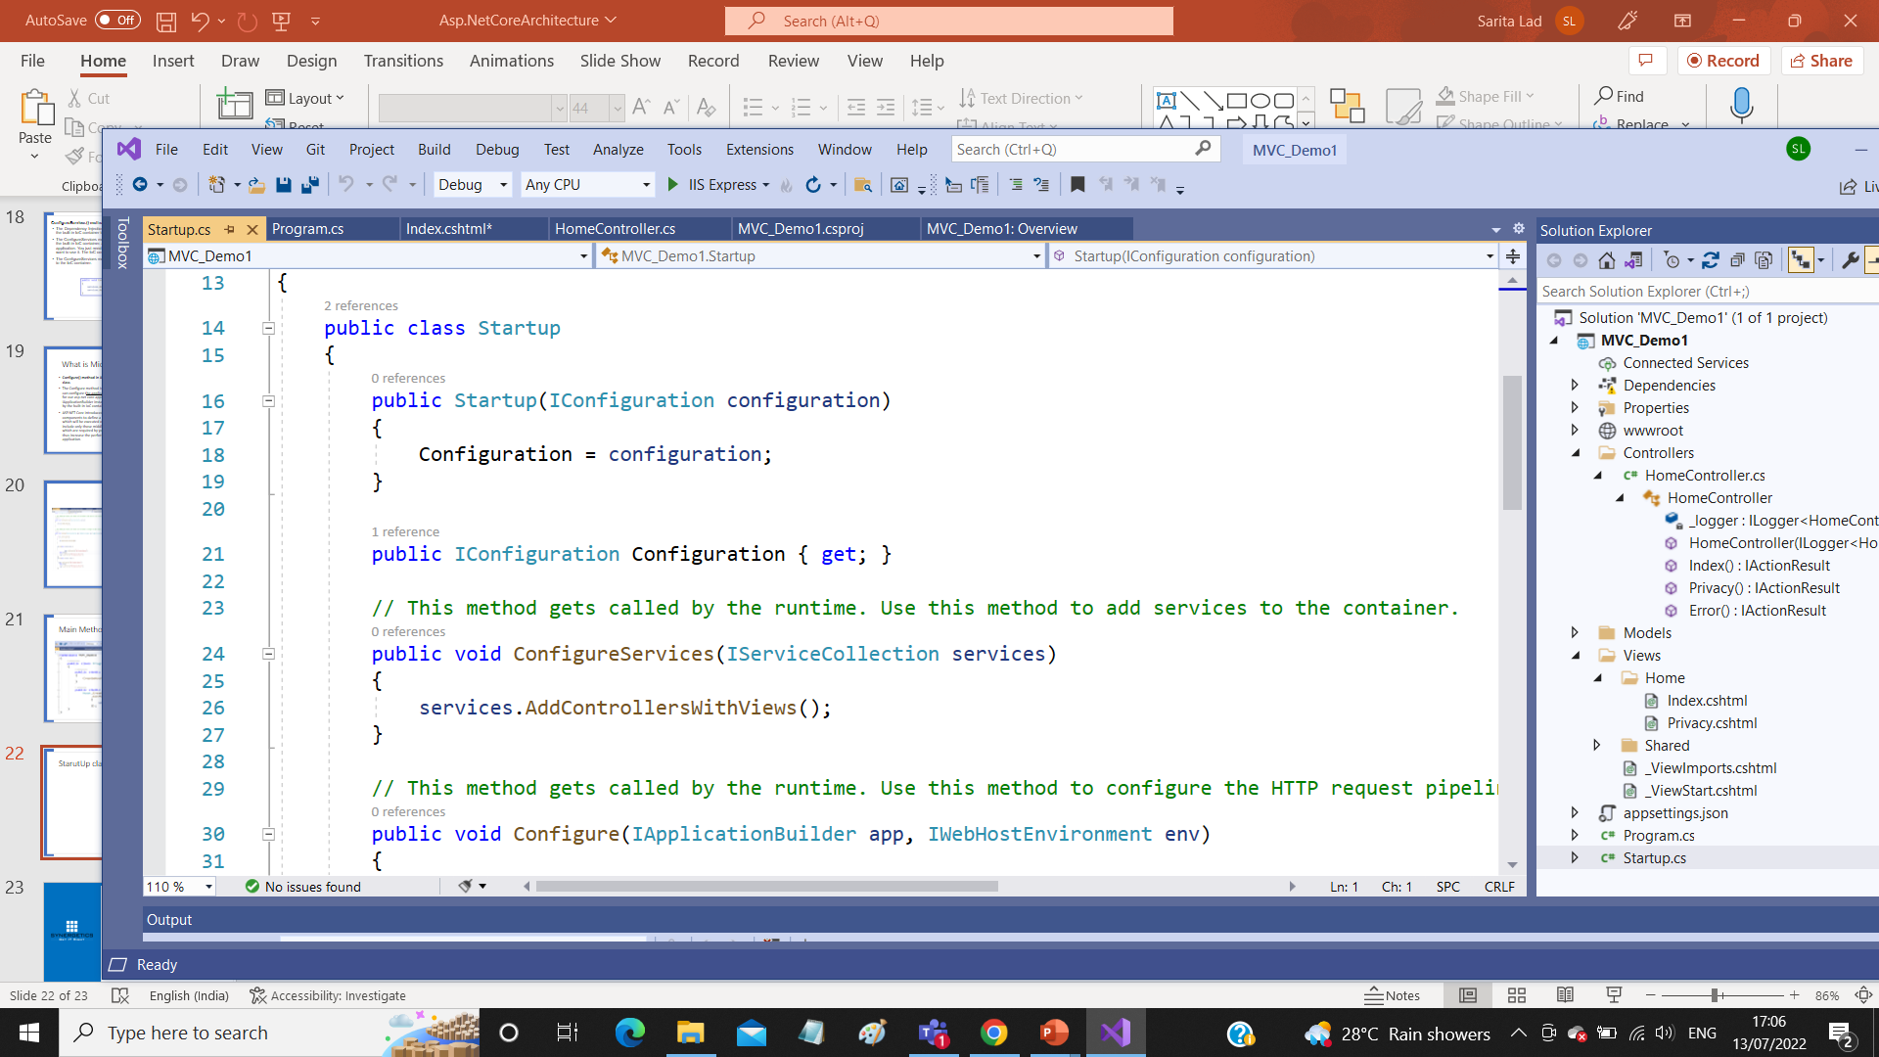
StarutUp class and StartUp File

Slide 31
Dotnet CLI interface
https://dotnettutorials.net/lesson/asp-net-core-command-line-interface/
Command Line Interface
Asp.Net Core is Open Source and Cross platform
Therefore if we want to develop .Net App on Linux OS
We have to use Command Prompt or PowerShell
It has provided support to This using Command Line Interface
Following are few commands used on CLI
C:\>dotnet –version
Dotnet new console –name mycosoleapp1
dotnet new console --name myconsoleapp23 --framework net5.0
dotnet new razor --name myrazorapp
dotnet new console --language "F#“
dotnet new classlib --framework "netstandard2.0" -o MyLibrary
dotnet new mvc -au None
Dotnet build
Dotnet run
https://learn.microsoft.com/en-us/dotnet/core/tools/dotnet-new

Slide 32
Thank You
dotnet add package Newtonsoft.json
dotnet remove package Newtonsoft.json
for mac machine
for install - dotnet tool install --global dotnet-ef
to add migration - dotnet ef migrations add m1
to update database :
dotnet ef database update

